Slide 1
Project Presentation
Name: Ray-Shaun Bourne
Teacher: Miss. Tora Simpson

Slide 2
Aim/Overview of project
The aim/overview of this project was to design and build (design using software such as AutoCAD and Fusion360) a small working model of a hovercraft with a system that allows the hovercraft to propel horizontally covering a distance of four yards. In addition, research and study were done to better understand the concept of the hovercraft which uses a horizontal and vertical propulsion system. The objectives/requirements of this project were that:
1. The hovercraft should be able to cover four yards or more.
2. Should be designed where it would be able to fit in a person’s hand.
3. Hovercraft must be designed so that it could travel on land surface.
4. Must be designed so that be able to produce enough air cushion for it to
over and produce enough thrust to move along the ground by itself.
5. Made of simple materials (Materials of plastic or foam etc.).
6. Budget of $50.

Slide 3

Design 1

Slide 4
Design 1 cont’d
Design 1 was drawn using AutoCAD. The design uses three fan blades, a control panel and powered by two batteries. The design also contains the skirt (which is the outside region of the design.)

Slide 5
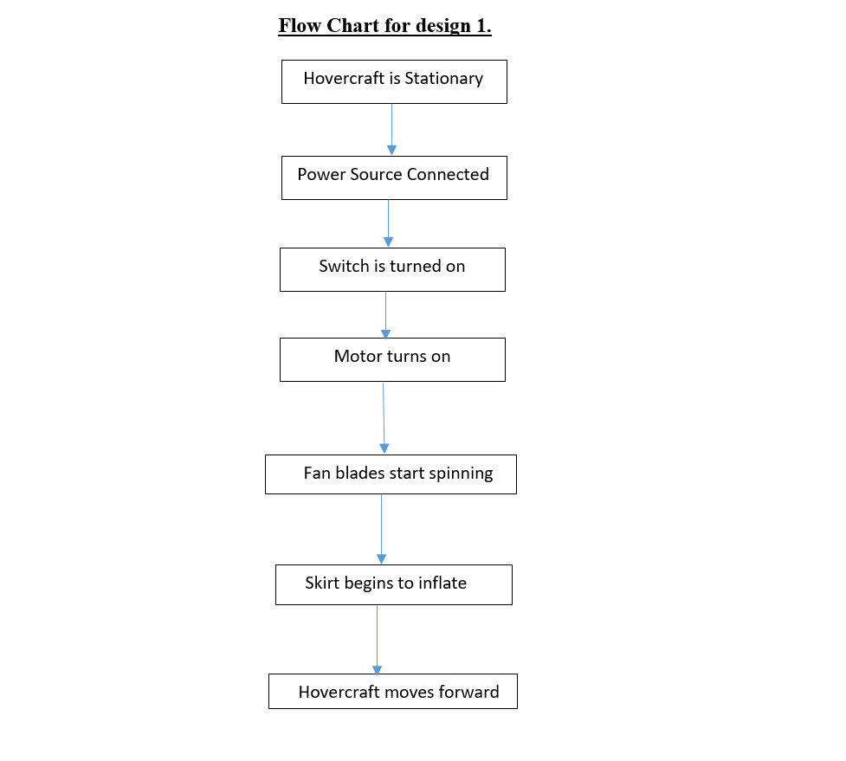
Flow Chart for design 1

Slide 6
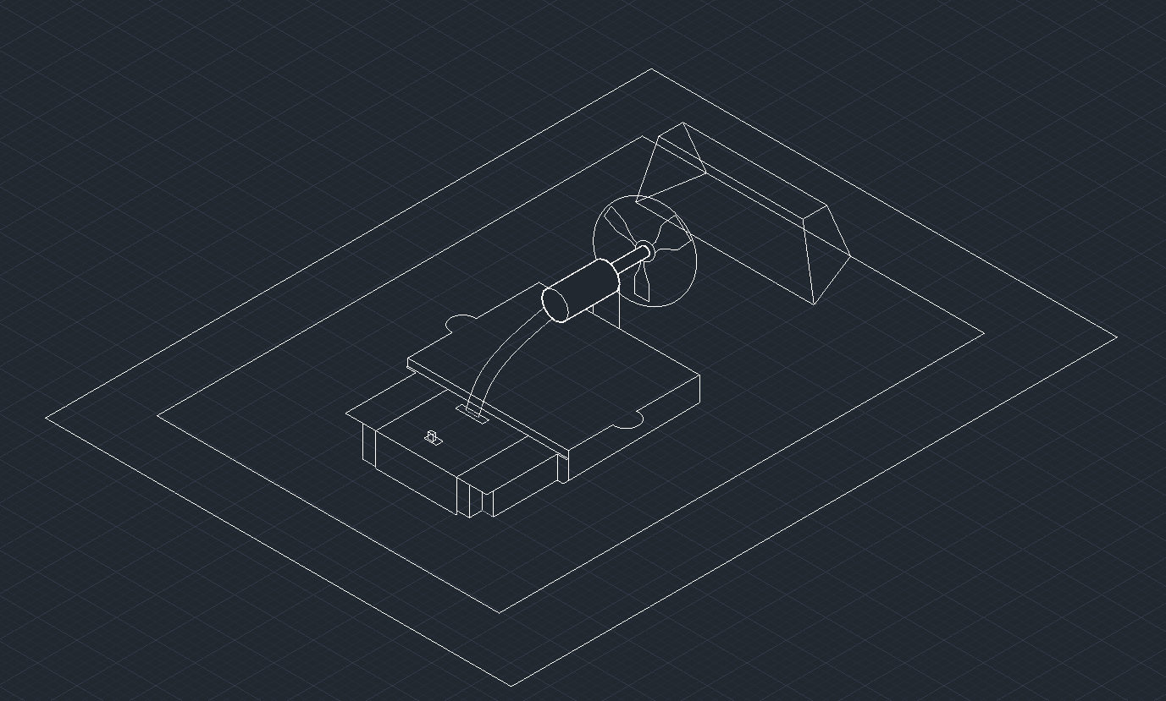
Design 2

Slide 7
Design 2 cont’d
Design 2 was drawn using AutoCAD. The design uses one main fan blade which propels the hovercraft horizontally/forward. In the middle of the design is the control panel which is powered by four batteries and holds a switch as well.

Slide 8
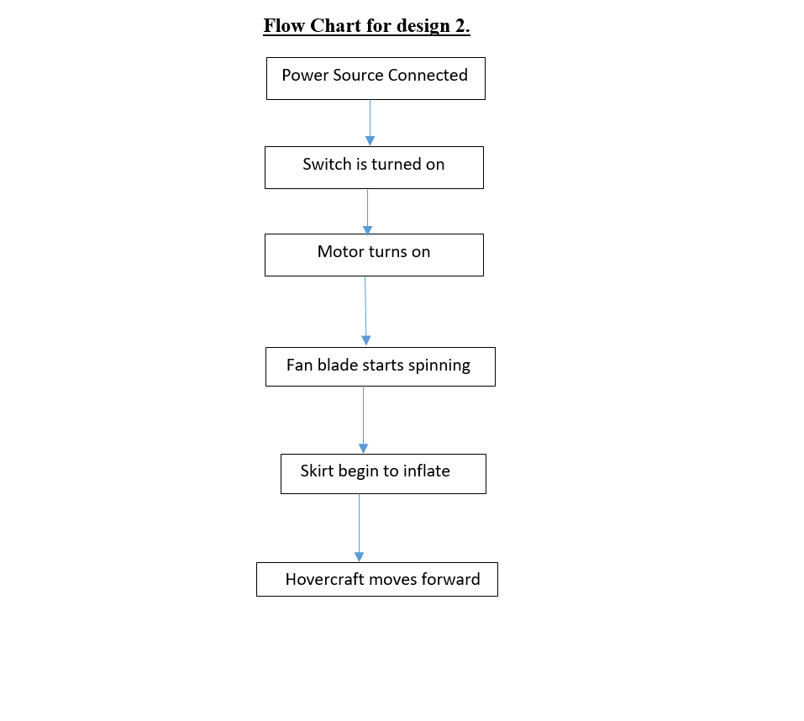
Flow Chart for design 2

Slide 9
Criteria Matrix
Evaluation Matrix: | Possible Effectiveness Score | Score for Design 1 | Score for Design 2
1. Cost Effectiveness | 40 | 25 | 30
2. Weight | 20 | 10 | 10
3. Travels 4 – 6 ft | 20 | 10 | 15
4. Simplicity | 10 | 10 | 5
5. Power Consumed | 10 | 8 | 10
Total effectiveness score | 100 | 63 | 70

Slide 10
Reasoning for criteria Matrix
Based on the Criteria Matrix, design 2 was selected. For cost effectiveness design 1 would be more expensive than design 2 because of the extra cost of getting three fan blades and possibly 3 dc motors as compared to design 2 which only utilizes one fan blade and one dc motor. The only disadvantage for cost effectiveness with design 2, it uses four batteries compared to design 1 it uses two batteries. In terms of weight Design 1 and Design 2 match up. In terms of travelling 4 – 6 ft. both designs would travel in that distance however, design 2 based on the battery power would more than likely travel farther than 4-6 ft. Based on simplicity design 1 has a simpler build compared to design 2. As for the Power Consumed design 1 would consume less power compared to design 2.

Slide 11
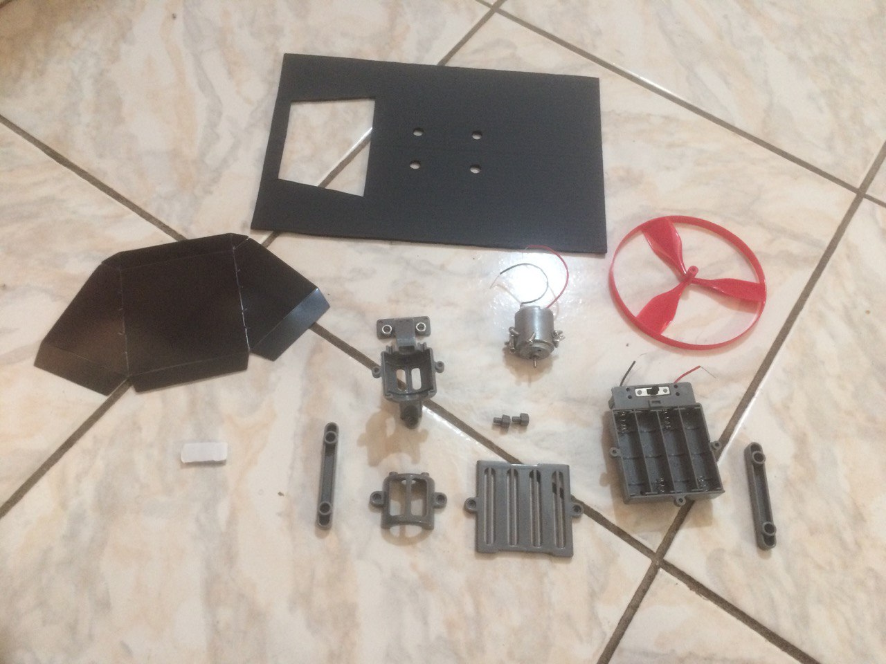
Materials/Components

Slide 12
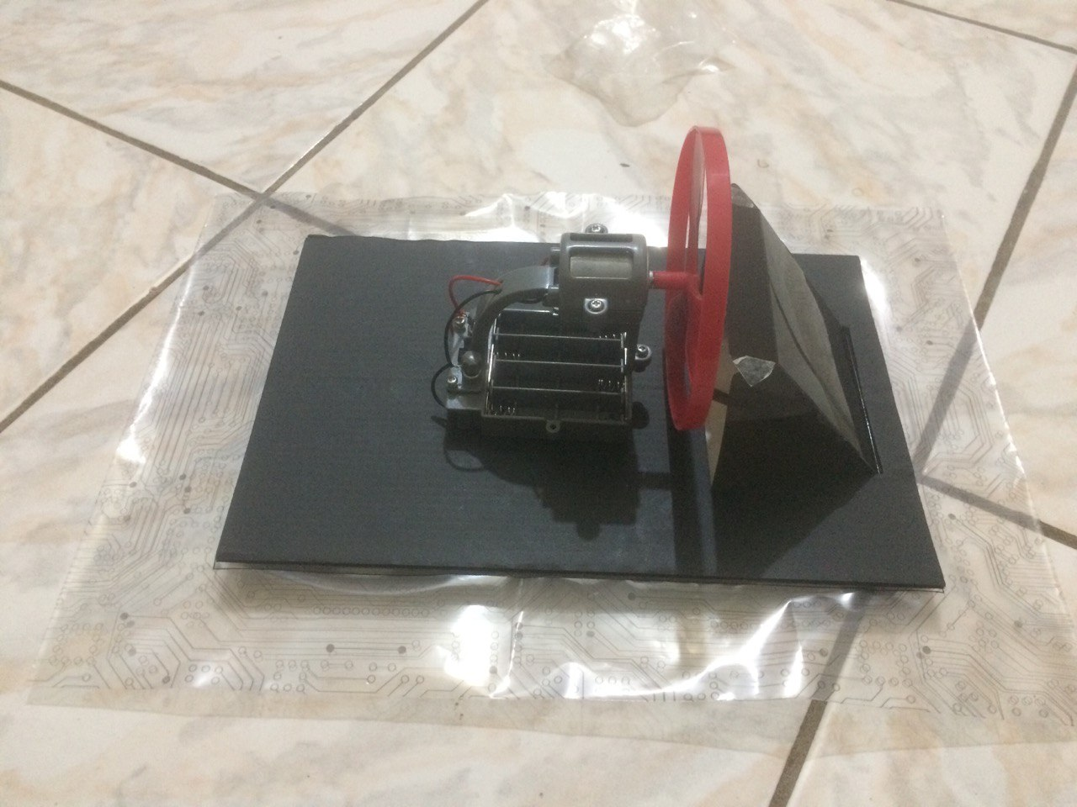
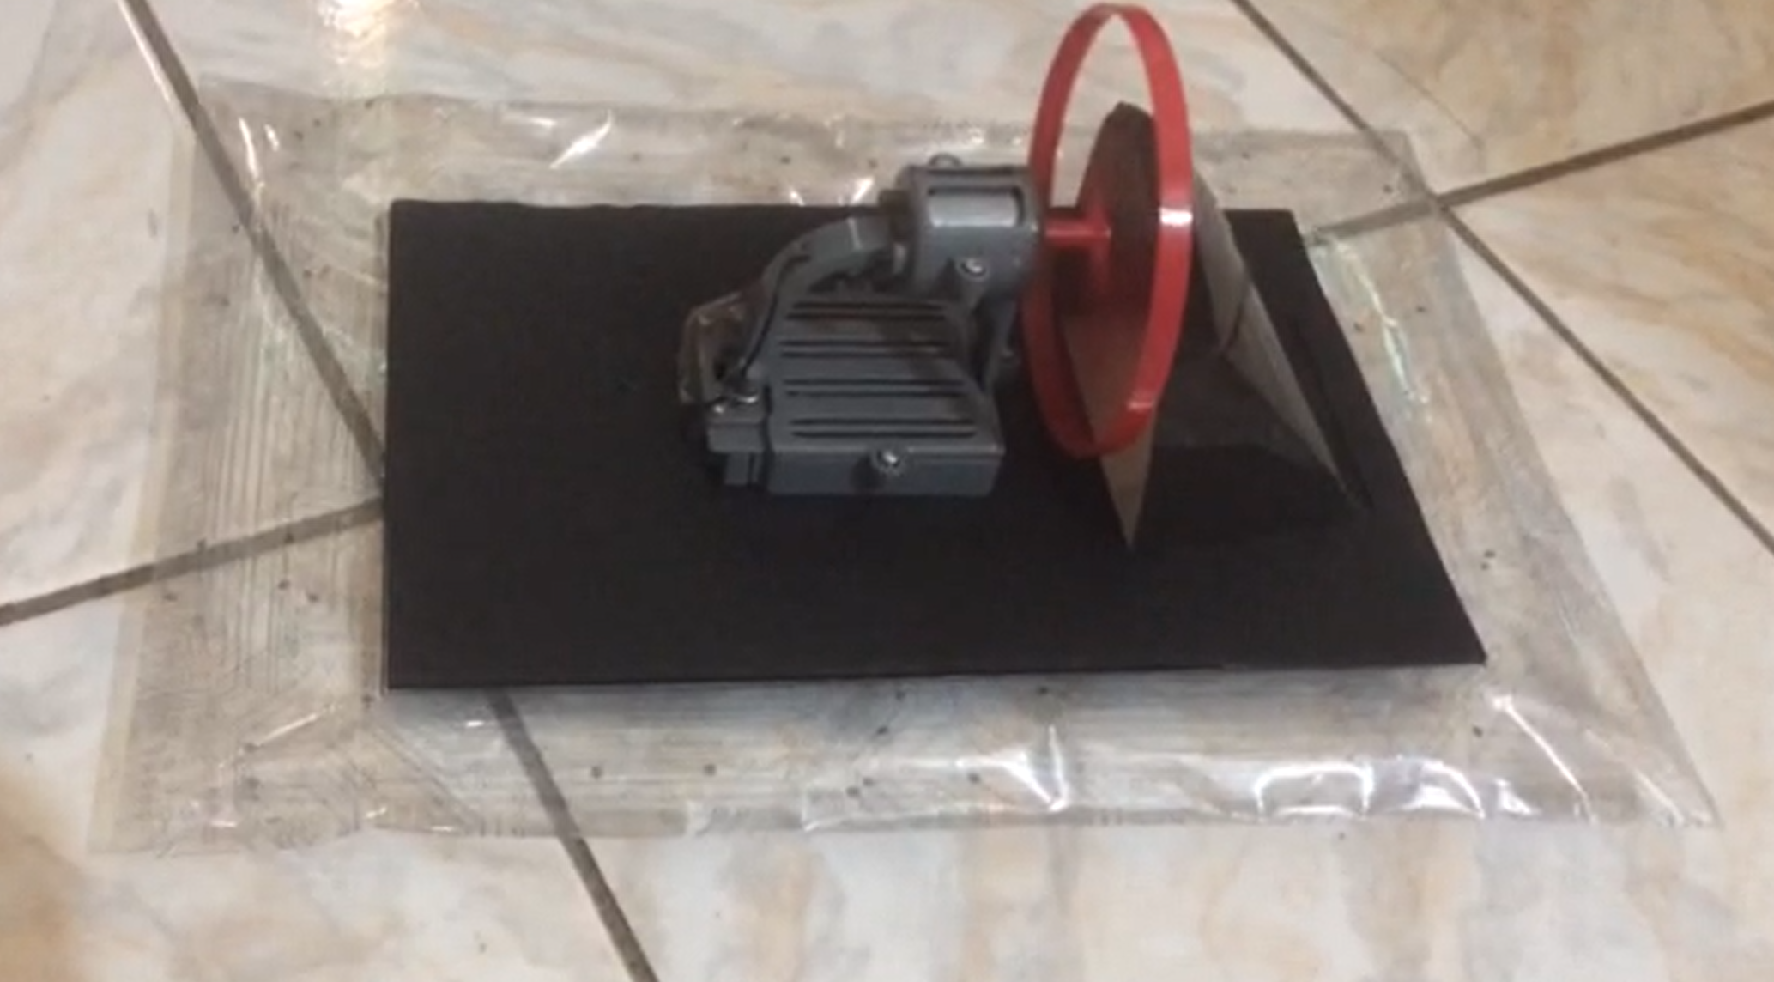
Complete Design of Hovercraft

Slide 13
Hovercraft Testing
Link to the hovercraft testing - https://drive.google.com/file/d/1-7UWdMDE_i0_StlAzXNzuWABtanbI-La/view

Slide 14
Hovercraft Testing (Cont’d)
Link to hovercraft testing - https://drive.google.com/file/d/1l2z3n_Z4ZOBfJyxkESqjygHjZbbecrVF/view

Slide 15
Things learned from the project
1. Origin of the Hovercraft
2.How a hovercraft works
3. How wiring connections works
4. How important it is not to have a damaged wire

Slide 16
Recommendations
1. Ensure that the materials you are using are strong enough and durable (especially the wires).
2. Ensure the most important parts of the hovercraft such as the skirt is properly made with the right material.
3. Ensure that you have strong knowledge of wire connection before attempting to wire anything.
4. Ensure the model that you build uses strong enough batteries for it to work.

